Slide 1
Reducing Girls’ Dropouts : What Works?
Dr. Sreeparna Ghosh, assistant Professor, school of development, azim Premji university.

Slide 2
Outline
Context of the problem
Reasons students drop-out
Specific reasons for girls
Current scenario
Nationally
State Wise
A case study of a district
Data Sources: DISE 2011-2012, 2012-2013 and SEMIS 2012-2013
Feasible interventions and Policy Options for Karnataka

Slide 3
Why do children drop-out?
Multiple reasons: Risk factors exist even prior to enrollment: poverty, low educational attainment of parents, pattern of schooling of siblings, a lack of pre-school experiences, child’s gender (Chugh 2011).
Family characteristics: Migration linked to livelihoods, undervaluing of education because of a perceived lack of relevance and economic circumstances especially at the primary level (APF Yadgir Study 2013), mother’s literacy (Siddhu 2010, APF 2013), belonging to a marginal group (Siddhu 2011)
Certain school and child characteristics which interact together such as poor performance in school brought on by a disinterest in school, an inflexible curriculum, lack of motivation and teacher characteristics that can negatively affect children.
Notes:
Chugh’s study was conducted in the slums of Delhi while Siddhu’s study was conducted in a farming village in U.P. For example Sidhu’s study in U.P. found that even in government schools, the additional cost of schooling in secondary school was 2370 Rs per child. APF study was done in Yadgir district

Slide 4
Reasons contd…
School and classroom characteristics: Distance to school, Unsupportive school/classroom environment, school infrastructure such as lack of toilets, absenteeism of students (one of the best predictors of non-transitioning) and teachers, attitude and behavior of teachers, schools not responding to student needs (Chugh 2011)
Educational outcomes related factors: Failure or repetition in the same grade, poor comprehension of school curricula (Siddhu 2010; 2011)
Costs associated with schooling: Direct and indirect costs of secondary education, including costs associated with distance to secondary schools and impacts of health-related factors (Siddhu 2010)

Slide 5
Specific Reasons Why Girls Drop-out
Linked to larger gender-inequities and an undervaluation of girls’ education
Additional costs which are considered not a worthwhile investment for girls because they do not contribute to their natal home expenses once married
Opportunity costs of sending girls to schools – for example care of sibling and domestic work foregone.
Early marriage norms for girls and the perception that girls at younger ages would require lesser dowries (Siddhu 2010)
Mother’s literacy plays a very important role, girls with more literate mothers are less likely to drop out (APF 2013)
Notes:
For instance the APF study found that the economic conditions for drop-outs matter more for girls than for boys among families who are poor and are living in a disadvantaged area. Siddhu found that girls who were “over-age” were less likely to transition to secondary school because of the commonly held perception that she is too old for school and a concern for their daughters safety and reputation.

Slide 6
What are the enabling conditions for girls?
For transition to secondary schools the following are key (UNGEI 2014):
Reasonable distance to school
Functioning private, safe latrines and acceptable menstrual hygiene management (MHM) facilities and basic reproductive health education;
Safety and security in the school environment
Presence of female teachers in school
Relevance of curriculum to life skills and labour market opportunities.

Slide 7
KARNATAKA

Slide 8
Current Scenario at the Secondary Level
The secondary average annual drop-out rate in Karnataka is 40%, the highest in the country.
Transition to secondary schools a serious problem for girls
Nearly 33% of secondary schools teachers in Karnataka do not have a graduate degree, the highest in the country.
Of all the southern states it also has the lowest % of teachers with a professional qualification
The percentage of students enrolled in government (36.46%)and private aided schools (32.2%) are similar in Karnataka.
In TN, more students in government schools, in Kerala, substantially more in private aided schools and in A.P, highest proportions in Local Body Schools.
Gulbarga and Bidar already under Special Focus Districts and for Beti Bachao Beti Padhao, Bijapur is the focus (Gender Atlas of SEMIS).
Source for all data: SEMIS 2013-14
Notes:
- However the % of teachers with a professional qualification is higher than the Indian average 92% as opposed to 85%

Slide 9
Current scenario contd..
The primary problem areas for KN are toilets and teacher qualification
At the secondary level the most challenging districts are Yadgir, Koppal, Raichur, Gulbarga and Bidar.
Academic achievement – For girls who do make it to secondary and higher secondary, the pass percentage is significantly higher for all of Southern states as well as for India.
Region | Sec Boys | Sec Girls | H.Sec Boys | H.Sec Girls
Karnataka | 82.2% | 85.2% | 68.63% | 76.25%
Kerala | 93.7% | 95.5% | 79.4% | 86.6%
Tamil Nadu | 86.2% | 91.6% | 84.6% | 90%
Andhra Pradesh | 89.6% | 89.7% | 72.5% | 75.9%
India | 79.1% | 80% | 77% | 81%

Slide 10
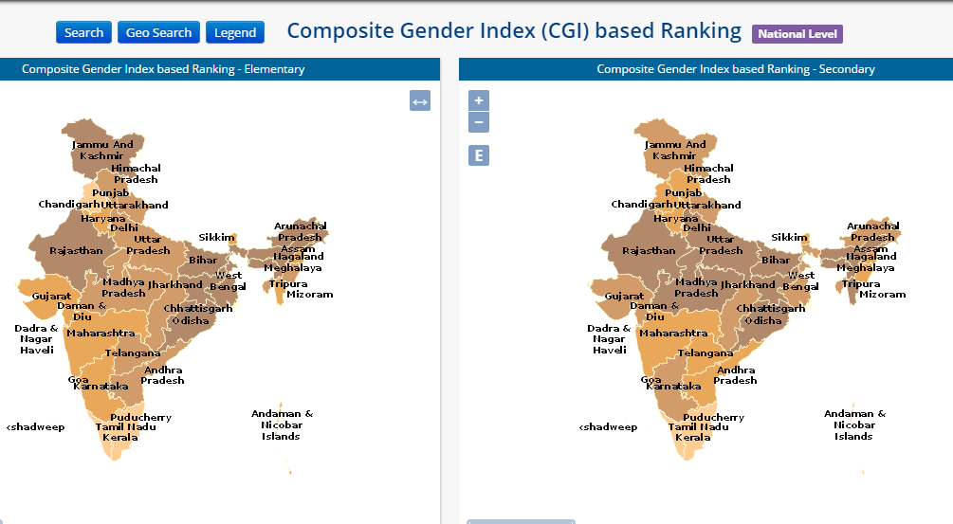
State Ranking on Gender and Development Indicators
Source: SEMIS, Digital Gender Atlas for Advancing Girls’ Education, UNICEF, SSA and MHRD
Notes:
Composite Gender Index (NUEPA) based on 23 Education Development Indicators divided into access, infrastructure, teachers and outcome indicators. At the district level- Gulbarga, Bidar and Yadgira have the most disadvantage. While the performance of Karnataka is better where elementary education is concerned for secondary education, it performs not as well putting it in the same group as Bihar, Orissa, U.P and Rajasthan

Slide 11
Early marriage contributes to drop-outs
Marriage Below Legal Age | Boys | Girls
Bidar | 13.9 | 26.8
Chitradurga | 11 | 27.8
Gadag | 7.7 | 33
Bellary | 18.2 | 34.8
Raichur | 28.2 | 35.3
Bijapur | 16.5 | 38.4
Gulbarga | 18.5 | 41
Koppal | 18.4 | 41.5
Belgaum | 13.1 | 42.6
Bagalkot | 16.3 | 43.6

Slide 12
How data can help
A focused Block-specific approach is required even within districts which are disadvantaged.
For example analysis of data from SEMIS reveals the following:
In Gulbarga in Afzalpur Block, the main problem is access to a secondary school with just 77.27% of schools accessed through all-weather roads in contrast to 100% in Aland, Gulbarga South and Sedam.
With the exception of Gulbarga North, all schools have toilets.
With the exception of Jewargi, all blocks have functional toilets.
Therefore Gulbarga’s school infrastructure issues required a multi-pronged approach where different Blocks will necessarily have different needs.

Slide 13
Policy lessons from around the world

Slide 14
Possible Policy Options
Since cost of secondary education and distance to schools are some of the key “supply” side factors, then interventions need to address both.
In some areas of the world (Kenya and Mexico) conditional cash transfers linked to attendance in schools have worked (Evans et al 2008; Fizbein and Schady 2009).
Female stipend program (introduced in 1994 in Bangladesh) gives a monthly cash assistance conditional on attendance and academic performance is a successful example (Nobuhiko 2001 and Khandker 2003)
Most importantly studies from Bangladesh indicate that female drop-out rates are most responsive to parents being persuaded that education will lead to livelihood options for their daughters (Mobarak 2012; Heath and Mobarak 2012). The expansions of female employment in the Bangladeshi garment industry is credited with many gender-equitable developments including later age at marriage, longer duration in education and more economic empowerment for women.
Thus in areas where there is a lack of “demand” for girls’ education even if there is an adequate supply of schools with the required infrastructure, education, unless a joint-up approach is devised where livelihoods, school education and adult education are linked, there can be little success.

Slide 15
Interventions
Preventive and Restorative Efforts (Chugh 2011)
Socioeconomic circumstances will not change in the medium term. However a focus on access to schooling, attendance monitoring ,infrastructural improvements, flexible curriculum and improving teacher motivation are likely to yield better retention.
Secondary Schools should be built in places where the risk of drop-outs are the highest and within commutable distance to children’s homes.
If building permanent structures is a problem, mobile schools could offer some solutions, for example in Odisha, a program has successfully included street children by locating mobile schools near railway stations (Datta and Banik 2014)
Strict implementation of RTE norms of 25% reservation for poor children and subsequent monitoring to ensure expanded access in underserved areas.
Certain measures are already in place to reduce the costs of schooling- further measures need to be incorporated if financial constraints are the primary cause of drop-outs so that out of pocket expenses for parents are tending to zero.

Slide 16
Interventions contd…
Children at the highest risks of dropping out in elementary school need to be identified by reviewing their performance and attendance.
To address deficits in learning, bridge courses can be organized during the summer session for those children at risk of dropping out, creatively designed so students enjoy the curriculum.
Performance improvement is an important reinforcement for students at risk of dropping out.
Therefore important to address classroom transactions, pedagogy and teacher and student motivation, all of which are known to improve performance.
Assistance to teachers in developing instructional materials and a flexible curriculum and in particular attention needs to be paid in teaching science subjects for students at risk of school failure.
Notes:
Absenteeism is the best predictor of future drop-outs

Slide 17
Interventions contd…
A flexible curriculum that offers skill-oriented subjects so both parents and students can clearly see the links between education and livelihoods.
Restorative efforts specifically focus on allowing the child to get readmitted once he/she has dropped out easily
Adult education classes could also form part of a suit of measures for restorative efforts.

Slide 18
References
Azim Premji Foundation. (2013). Who Drops Out of School: Evidence from an Action Research Study in Yadgir Karnataka. Bengaluru: Azim Premji Foundation.
Clotfelter, C. T., Ladd, H. F., & Vigdor, J. L. (2007). Teacher credentials and student achievement: Longitudinal analysis with student fixed effects. Economics of Education: Major Contributions and Future Directions - The Dijon Papers, 26(6), 673–682. http://doi.org/10.1016/j.econedurev.2007.10.002
Chugh, S (2011): Dropout in Secondary Education: A Study of Children Living in Slums of Delhi National University of Educational Planning and Administration Occasional Paper No, 37
Datta, D., & Banik, D. (2014). “If the child cannot come to the school, then the school must go to the child”: The railway station platform schools in Odisha, India. Education 3-13, 42(4), 369–385
Fiszbein, A and N R Schady (eds.) (2009), Conditional Cash Transfers: Reducing Present and Future Poverty, World Bank Publications.
Fuwa, Nobuhiko (2001), The Net Impact of the Female Secondary School Stipend Program in Bangladesh, University Library of Munich, MPRA Paper. No. 23402.
Harris, D. and Sass T (2010). What makes for a good teacher and who can tell? Urban Institute Working Paper Series . Number 30 . September 2009
Hiremath, M. (2014). A Study on Constitutional Provisions for Educational Rights of Women and Minorities in India with its Implementations in Karnataka State.
Josephine, Y. (n.d.). Impact of mid day meals programmes on enrolment and retention of girls in primary schools of West Garo Hills in MeghalayaHeath, R and A M Mobarak (2012), “Does Demand or Supply Constrain Investments in Education? Evidence from Garment Sector Jobs in Bangladesh”, Working Paper.
Jensen, R (2010b), Economic Opportunities and Gender Differences in Human Capital: Experimental Evidence from India, NBER Working Paper Series, No. 16021.
Khandker, SR, MM Pitt, and, F Nobuhiko (2003), Subsidy to Promote Girls’ Secondary Education: The Female Stipend Program in Bangladesh, MPRA Paper. No.23688.
Mobarak, A.M (2012) How to keep more girls in school: Lessons from Bangladesh Access at : http://www.ideasforindia.in/article.aspx?article_id=57#sthash.hsP5PbKW.dpuf
Siddhu, G. (2011). Who makes it to secondary school? Determinants of transition to secondary schools in rural India. International Journal of Educational Development, 31(4), 394–401.
…… (2010). Can Families in Rural India Bear the Additional Burden of Secondary Education? Investigating theDeterminants of Transition. CREATE Pathways to Access Research Monograph No. 50 November 2010, University of Sussex, IDS
UNGEI (2014) Accelerating Secondary Education for Girls: Focusing on Access and Retention Discussion Paper Series.

Slide 19
Appendix
Digital Gender Atlas for Advancing Girls’ Education
The Atlas is based primarily on District Information System for Education (DISE) and Unified District Information System for Education (U-DISE) data (2011- 2014), the National Education Management Information System (EMIS) for elementary and secondary education.
The Atlas draws on the Census of India 2011 for data on rural female literacy rates, working children in the school going age group, and the District Level Household and Facility Survey (DLHS) 2007-08 for data on age at marriage.
No primary data has been generated for developing the Atlas.
The analysis framework and formulae used in the EMIS has been used for data analysis and indexing. See the web link provided in the Indicator menu for further details on formulae used.
The Atlas uses the quartile ranking method to provide a comparative picture of performance on gender related education indicators within specific geographies. The quartile method simply partitions the data into four groups.Quartile 1 or the lowest group contains the data points which accommodate the lowest 25% of data and so on for each subsequent group of data. This is a broad segregation of the data for visualization and the variation of data range with in the quartiles can be different from map to map. Thus, the data range for each quartile for an indicator is created on the basis of the lowest and highest value of data for that particular indicator by dividing them into four parts.
Source: http://mmistech.com/atlas/about_atlas.html

